Slide 1
NBAC TSC Slides 31 July 2025 Meeting
Stephen Sullivan

Slide 2
31 July 2025 NBAC TSC Agenda
1:00 NBAC Chair (s) Opening Remarks – Mr. Kamran Atri, Thomas Krul & Paul Wormeli
1:10 NIEM Management Office (NMO) Update – Mr. Steve Sullivan
28 Aug PGB Meeting
8 October NPC Co-Chair and Member Meeting
13 November Reveal Summit Webinar
NDR PS01 under review before PGB Vote
OS Statements of Use Model Version 6.0 in progress
OASIS-GTRI developer contract, signatures being gathered
1:20 NTAC Update – Scott Renner, Brad Bolliger
1:30 NIEM.gov transition – Darcy Staley
1:40 Communications & Outreach NMO Sub-Committee – Paul Wormeli
1:50 Questions/Final Remarks

Slide 3
August PGB
28 August, 2-4 PM EST
Virtual
Microsoft Teams
Join the meeting now
Meeting ID: 993 992 894 975
Passcode: Gs9YZ7DH
Dial in by phone
+1 410-874-6749,,878640958#
Supporting Documents: https://github.com/niemopen/oasis-open-project/tree/main/pgb-meeting-minutes/2025/28-aug-25

Slide 4
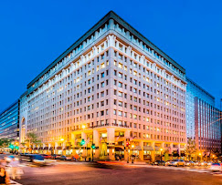

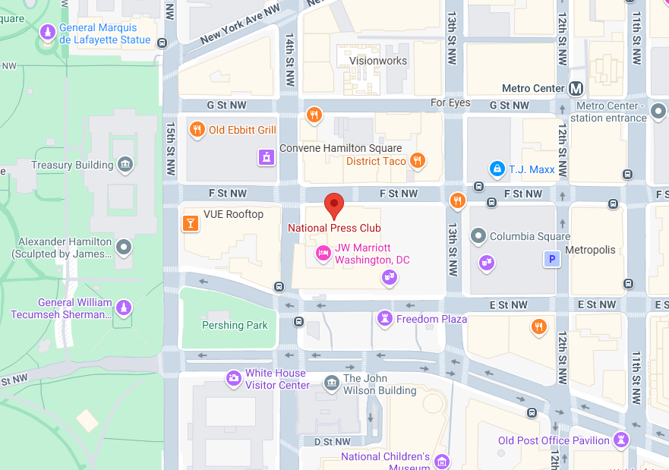
NIEMOpen Leadership Meeting National Press Club & Virtual
Date/time: 8 October 2025, ~ 9 AM – 4 PM
Venue: National Press Club & Virtual
529 14th St NW, Washington, DC 20045
“DRAFT” Agenda
Link for NBAC & NTAC Plenary Sessions: TBD
Link for AM & PM Joint Sessions & Q&A:
Microsoft Teams
Join the meeting now
Meeting ID: 993 433 963 845
Passcode: Sh3io32Y
Dial in by phone
+1 410-874-6749,,586002121#
Supporting documents: https://github.com/niemopen/nbac-admin/tree/main/8-october-co-chair-meeting-npc

Slide 5

NIEMOpen Reveal Summit
Draft Agenda
13 November, 9 AM – 4PM EST
Virtual Webinar
Host: IJIS Institute
Registration page, provided by IJIS, pending
Link, provided by IJIS, pending
Supporting Documents: https://github.com/niemopen/nbac-admin/tree/main/2025-reveal-summit

